Slide 1
The Molecular Basis of Inheritance
Chapter 16

Slide 2
Early understanding of inheritance
Is it DNA or proteins that are responsible for inheritance?
Which would you think had more overall ability to account for all the genetic variety among all the millions of species on earth?
DNA
is a polymer of nucleotides
Nucleotides have same sugar-phosphate backbone; nitrogenous bases are different
Essentially 4 options for variation
Proteins
polymers of amino acids
AA all have amino group, carboxyl, central carbon, and H
AA differ in R group
Essentially 20 options for variation

Slide 3
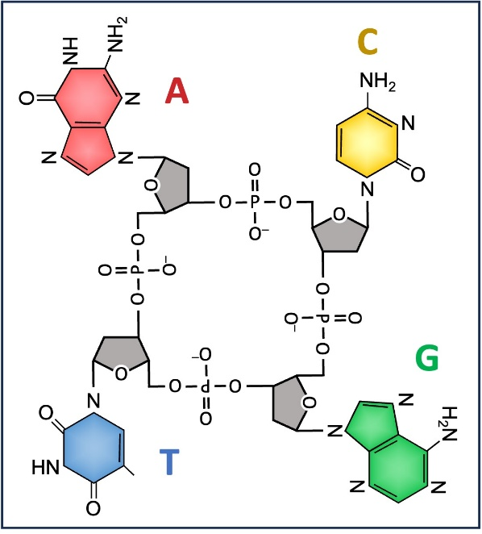
Original Idea: Tetranucleotide Hypothesis
1940’s- proposed that DNA was made up of nucleotides with 4 nitrogenous base options
But the bases occurred in equal quantities and in a repeating pattern, AGTC
Seen as simple and repetitive, so no way it could be responsible for housing our complex genetic information
Next logical suggestion was proteins

Slide 4
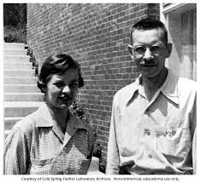
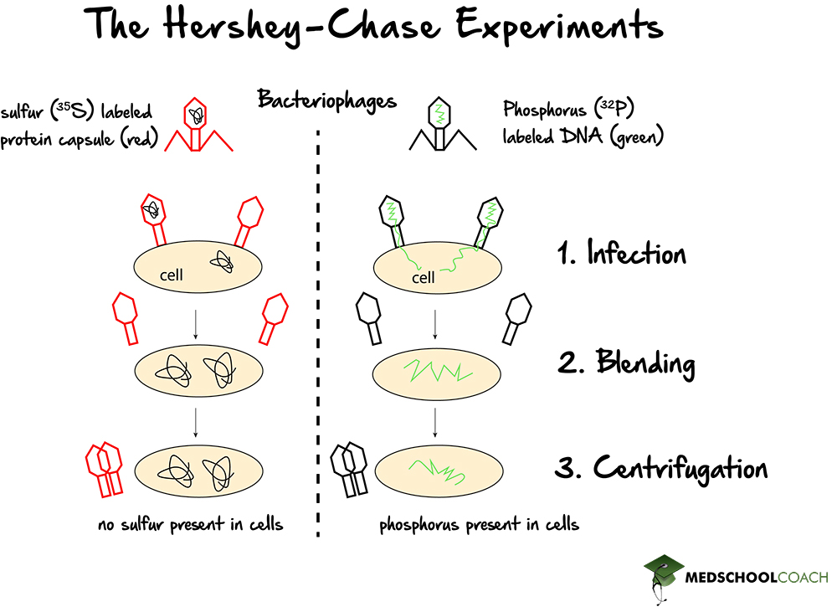
Landmark Studies
1952, Alfred Hershey and Martha Chase showed that DNA was responsible for genetic heredity

Slide 5
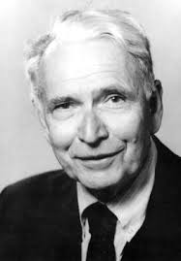
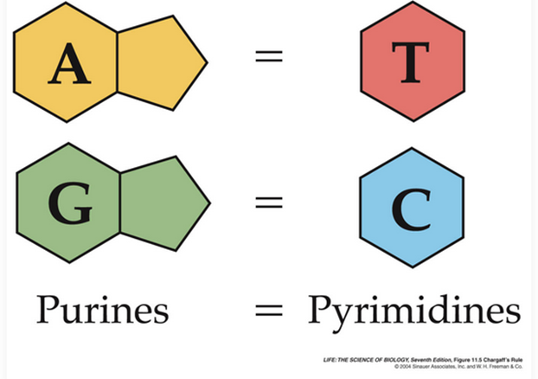
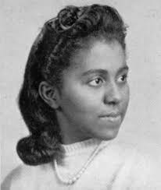
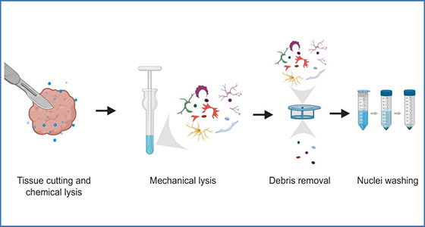
Landmark Studies
1950 Edwin Chargaff: Analysis of DNA (in an individual) amount of A = amount of T, and amount of C = amount of G
Also that DNA composition varies between species
1950, Marie Maynard Daly developed techniques to isolate the nucleus from cells and quantify what was inside (aka the DNA)
Demonstrated that there are exclusively 4 nitrogenous base options (ATCG), and those amounts varied across species
Largely also studied the organization of DNA, specially the histone proteins

Slide 6
Understanding Chargaff’s Rules
If a sample of DNA is 30% Thymine, how much Adenine does it contain?
  How much Guanine?
If a sample of DNA is 15% Cytosine, how much Thymine does it contain?

Slide 7
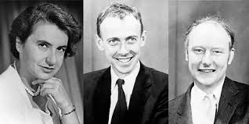
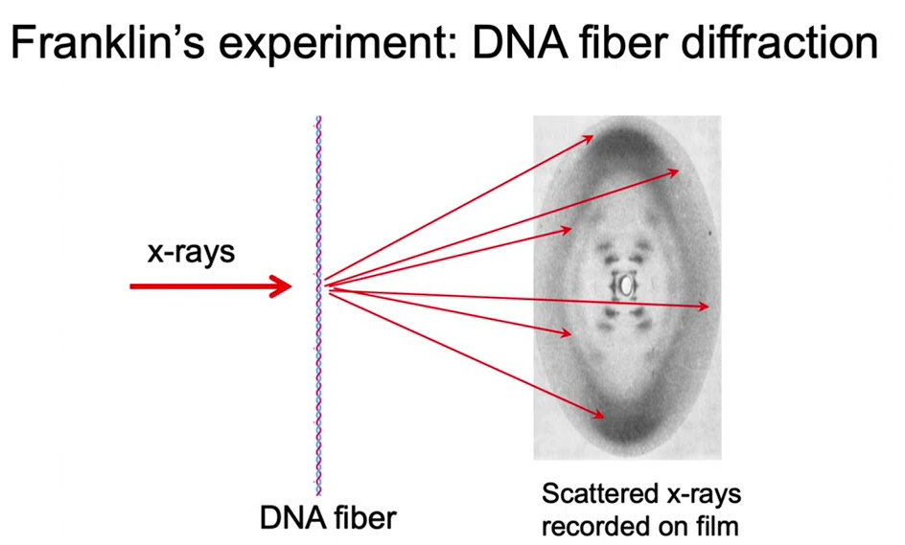
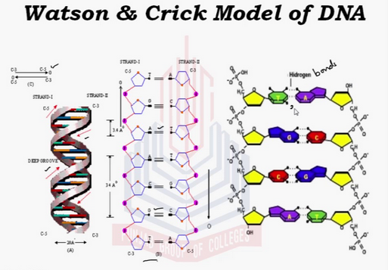
DNA Double Helix Structure
1953: James Watson and Francis Crick used x-ray diffraction to show the double helix nature of DNA structure
  Rosalind Franklin was expert at x-ray diffraction
  Her x-rays were used by Watson and Crick, but she received no credit for decades

Slide 8
DNA Double Helix Structure
Watson and Crick Model
Discovered purines bind with pyrimidines
  Supports Chargaff’s Rules
  Bonds between nucleotides are hydrogen bonds
  2 Hydrogen bonds between A-T
  3 Hydrogen bonds between G-C

Slide 9
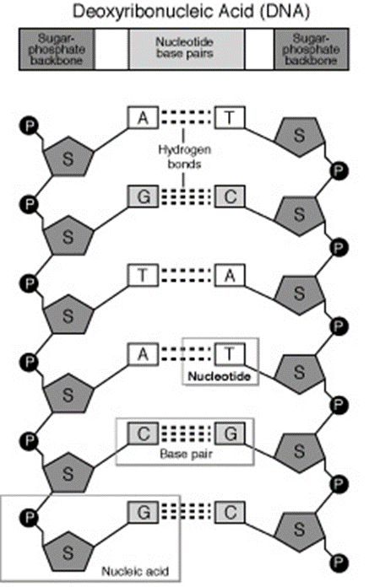
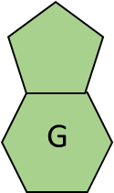
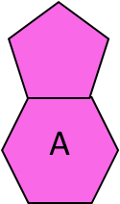
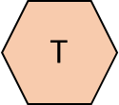
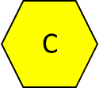
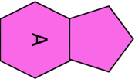
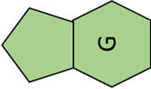
Base pairing rules
DNA width is consistent down the entire length of DNA strand
A and G are double ring purines
T and C are single ring pyrimidines
  If purines (A and G) bond with each other – DNA is too wide
  If pyrimidines (T and C) bond with each other – DNA is too narrow

Slide 10

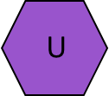
Base pairing rules
If purines bind with pyrimidines, DNA width is consistent
  In DNA
    C – G
    A – T
  In RNA
    C – G
    A – U (no T in RNA)

Slide 11

The combination and sequence of nucleotides in DNA provides the blueprint for making proteins that make an organism what it is.
  Just four nucleotides account for all the diversity on earth!
  Those nucleotides make up the genes that are passed down from one generation to the next
  Crucial that copying DNA is done carefully and correctly

Slide 12
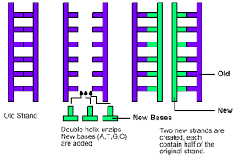
DNA Replication (Synthesis phase)
DNA is double-stranded, strands must be separated, and the helix structure unwound
This gives room for two new strands of DNA to be produced, using each original parent strand as a template.
Result is two strands of DNA that each have one parent strand and one newly synthesized strand
  These are the sister chromatids
  Semi-conservative

Slide 13
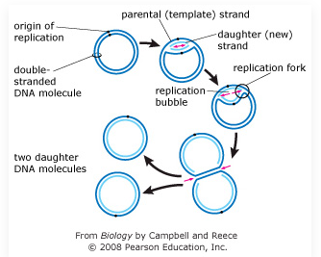
Prokaryote DNA Replication Origin
DNA replication begins at the replication origin
Prokaryotes (circular DNA) have only one replication origin
Replication proceeds in both directions

Slide 14
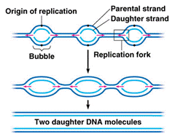
Eukaryote DNA Replication
Eukaryotes (linear DNA) have many replication origins along the length of DNA
Replication proceeds in both directions

Slide 15
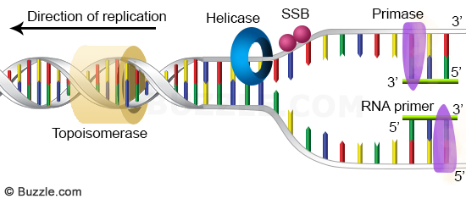
DNA Synthesis
Helicase is the enzyme that unwinds DNA at the origin of replication
  breaks the hydrogen bonds between nitrogenous bases
  Creates replication forks
Single-strand binding proteins (SSBP) attach to each of the unwound DNA parent strands to keep them from rebinding to each other
The unwound segments of DNA strands are now templates used to create two new complementary DNA strands

Slide 16
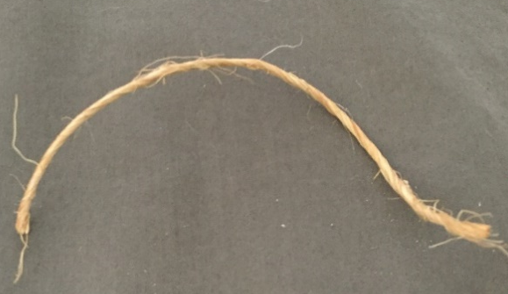
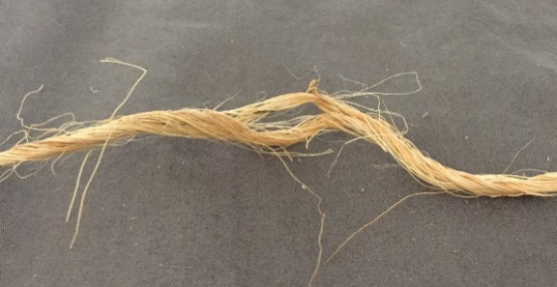
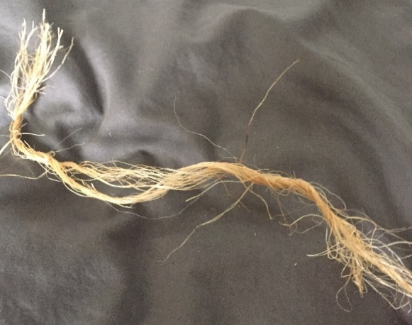
DNA over-winding and Topoisomerase
Replication proceeds in both directions, away from the origin of replication with Helicase moving in each direction, creating a larger area of replication
This creates over-winding of the DNA upstream of Helicase
Topoisomerase relieves this strain by breaking, rotating and then rejoining DNA strands.

Slide 17
DNA Synthesis
Primase starts by adding primer nucleotides to begin the new DNA strand
BUT…The primer is actually RNA nucleotides
  (DNA Polymerase I will eventually replace RNA primer nucleotides with DNA nucleotides)

Slide 18
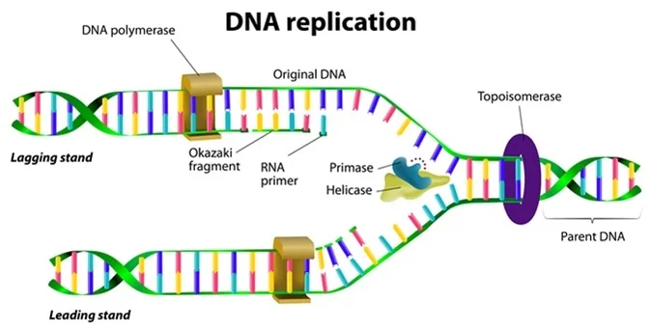
DNA Synthesis
Then, DNA Polymerase III adds new nucleotides, one at a time, to build the new complementary DNA strand, using the parent strand as a template
  500 nucleotides/second in bacteria
  50/second in humans

Slide 19
DNA Synthesis
New nucleotides can only be added to the 3’ end of the new DNA strand that is being built
Therefore, DNA can only grow in the 5’ → 3’ direction

Slide 20
DNA is anti-parallel
Since new nucleotides can only be added to the 3’ carbon, the synthesis of a new strand from the point of origin going towards the 5’ carbon on the template strand is continuous
  Leading Strand
  Only 1 primer needed
But the synthesis of a new strand from the point of origin going towards the 3’ carbon on the template strand is discontinuous
  New nucleotides are added in “chunks” called Okazaki fragments
  Lagging strand
  Okazaki fragements later joined together by DNA Ligase
  Many primers needed
Referring to the parent strand: runs 3’ to 5’
Referring to the complementary strand: builds 5’ to 3’

Slide 21
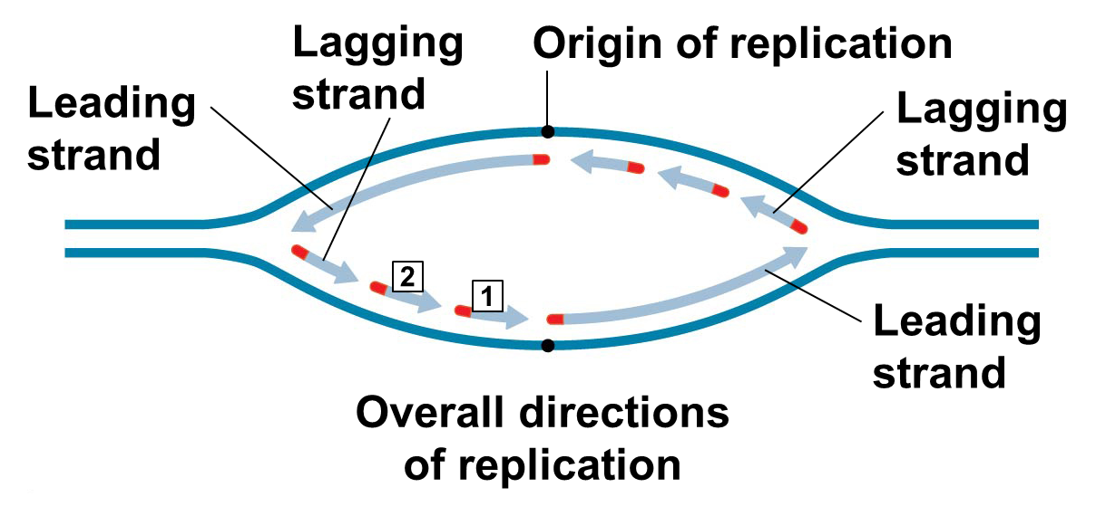
3’-5’
3’
3’
5’
3’-5’
5’
3’
5’
3’-5’
5’
3’
5’
3’
3’
3’-5’
5’
3’
5’-3’
5’
5’-3’
5’-3’
5’-3’

Slide 22
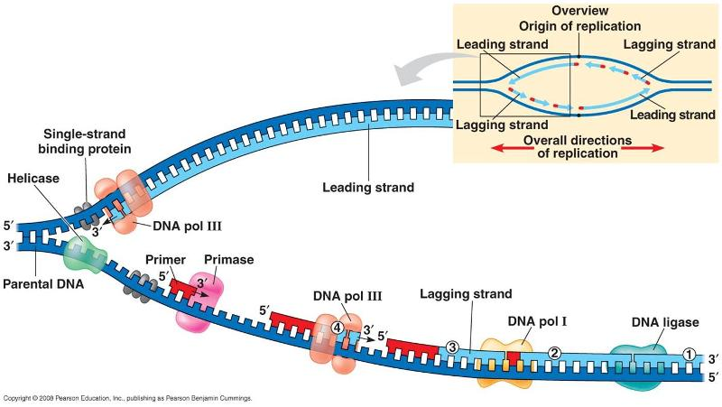

Slide 23
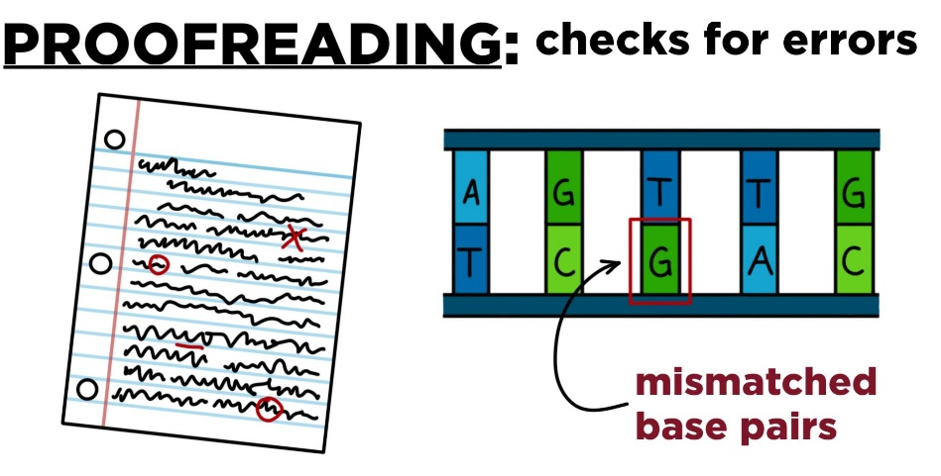
Proofreading DNA
Errors do occur during synthesis
  1 in 100,000 nucleotides
  Completed DNA has error rate of approximately 1 in 10 billion nucleotides
How are the errors during Synthesis corrected?
  DNA Polymerase III corrects most errors as they occur
  For mismatched nucleotides that are missed by DNA Polymerase, other enzymes correct the errors
Mutations are the result of failed proofreading
  Not always bad

Slide 24
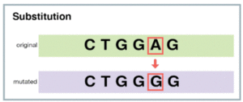
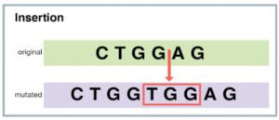
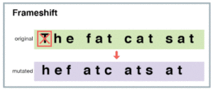
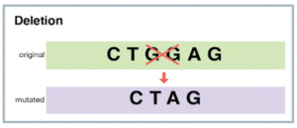
DNA Mutations

Slide 25

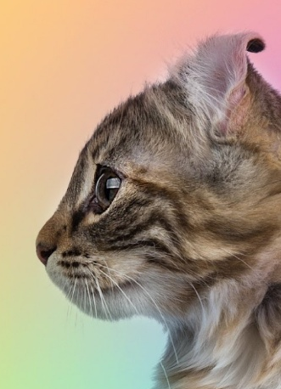
DNA Mutations
No/Neutral Effect
  Mutation occurs in stretch of DNA with no function
  Mutation doesn’t change amino acid sequence (silent mutation)
  Mutation has noticeable effect but not harmful
Harmful Mutation
  Mutation that affects ability to survive or reproduce
  Ex: Marfan syndrome; affects protein in connective tissue leading to heart and health issues
Beneficial Mutations
  Least common type
  Ex: DDT pesticide resistance in insects (can be single mutation)

Slide 26
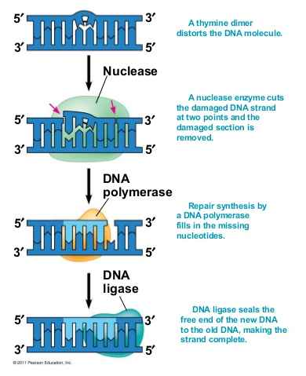
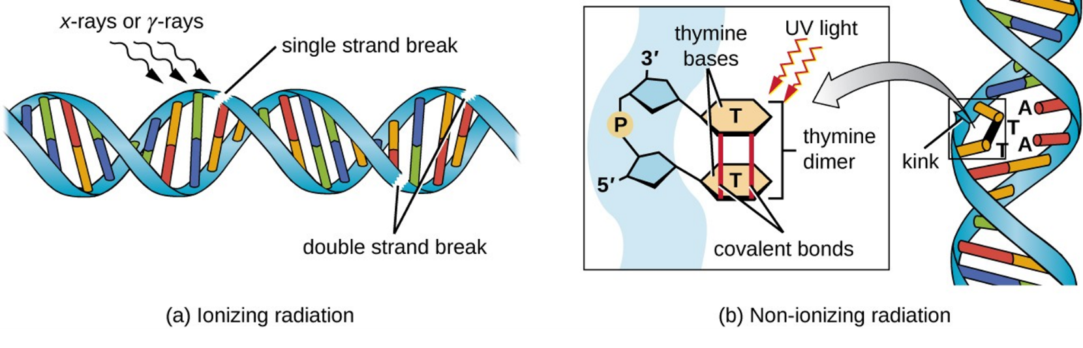
Repairing DNA
DNA damage can occur due to environmental factors
  UV exposure
Nuclease repairs DNA damage and synthesis errors
  Cuts out segment of incorrectly paired strand
  DNA Polymerase III can then fill in the gap with new (correct) nucleotides
  DNA Ligase seals the ends together

Slide 27
Evolutionary Significance of altered DNA nucleotides
Error rates are low but not zero – errors do occur
Those errors are mutations that can be passed down to the next generation
  Mutations in somatic cells won’t be passed to offspring
  Mutation in reproductive cells can be inherited by offspring
Mutations are the original source of genetic variation upon which natural selection acts

Slide 28
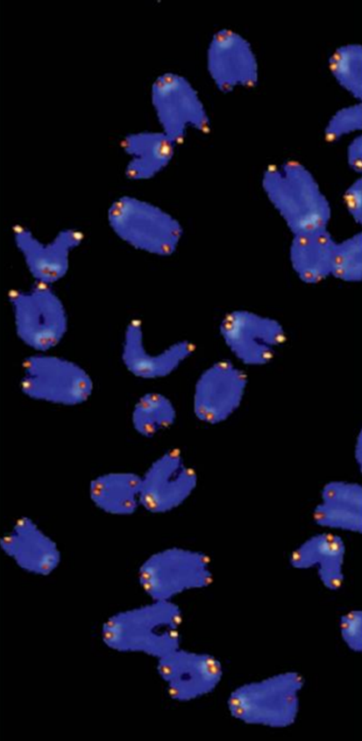
Replicating the ends of DNA molecules
Telomeres: nucleotide sequences in eukaryotes at each end of chromosomes
Telomeres are non-coding, short repetitive nucleotide sequences
  Humans: TTAGGG is repeated hundreds to thousands of times
  One TTAGGG sequence is “lost” with each replication event
  Telomeres become shorter but the DNA coding strand length is conserved
But what about ovary and teste cells that make gametes?
  They undergo meiosis repeatedly
  Age related to telomere length in ovary cells, decreased fertility with age
  Eventually even the telomeres would be lost and then essential genes would disappear as DNA is shortened

Slide 29
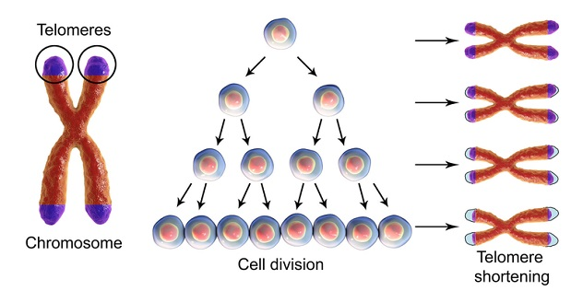
Replicating the ends of DNA molecules
DNA polymerase cannot replicate the 5’ ends
  Remember, nucleotides can only be added to the 3’ end of an existing nucleotide
Problem for Eukaryotes, not Prokaryotes
  Linear DNA vs. circular DNA
Repeated synthesis produces DNA that is shorter with each replication

Slide 30
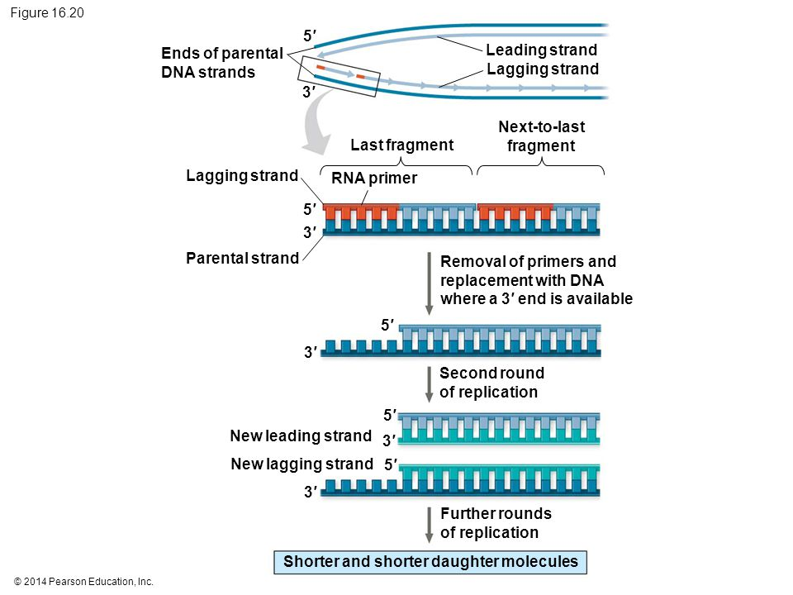

Slide 31
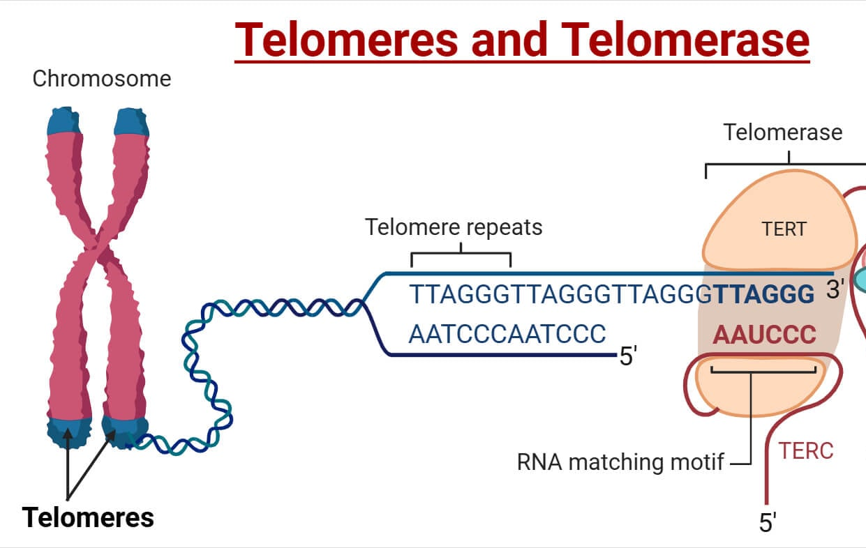
Telomerase in Germ Cells
In ovary and teste cells, telomerase catalyzes the lengthening of telomeres so that genes are not lost
  Good for germ cells, but may not be good for somatic cells
In somatic cells, normal shortening of telomeres may protect cells against cancer by limiting the number of cell divisions per cell
Cancer cells have been shown to have functioning telomerase
  Cancer cells can divide w/o limit if telomerase continues
  to lengthen the telomeres
Some cancer treatments are aimed at
inhibiting telomerase

Slide 32
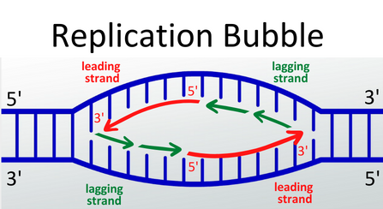
DNA Synthesis Practice
Label the leading and lagging strands

Slide 33
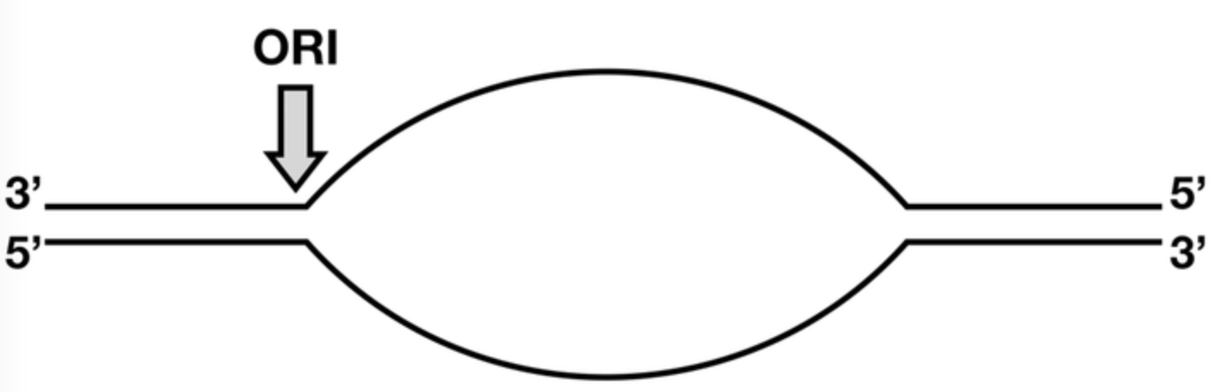
DNA Synthesis Practice
Label the Leading and Lagging Strands

Slide 34
DNA Replication needs enzymatic help
Helicase – unwinds DNA double strand, causes replication forks
Single strand binding proteins – binds to each open strand to prevent them from reattaching to each other
Topoisomerase – relieves the over-winding of DNA double strand caused by helicase
Primase – attaches primer of RNA nucleotides to begin DNA replication/synthesis
DNA polymerase III – adds nucleotides to grow the new DNA strands
DNA polymerase I – replaces RNA primer with DNA nucleotides
DNA ligase – joins Okazaki fragments together
Nuclease – repairs damaged DNA and replication errors
Telomerase – catalyzes lengthening of telomeres

Slide 35


